Slide 1

A New Dose-Response
Model for Treating Cancer with Particle Therapy
Melissa McIntyre (Presenter)
Dr Ayşe Kızılersü
Prof. Anthony Thomas
Special Research Centre for the Subatomic Structure of Matter, The University of Adelaide

Slide 2
Particle Therapy Overview
Conventional radiotherapy uses photons
Hadrons behave differently in matter compared to x-rays/photons
They allow us to deliver high doses to a small region whilst avoiding healthy tissues and organs at risk
melissa.mcintyre@adelaide.edu.au
1/12

Slide 3
Particle Therapy Overview
We also need to understand what happens inside the target when the particles reach it
To shrink the tumour we need to deactivate the cells within
We do this by breaking the DNA such that the cell cannot repair
There is still much to be understood about the mechanisms that govern how cells respond to radiation
melissa.mcintyre@adelaide.edu.au
1/12

Slide 4
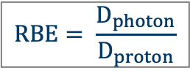
The Problems
$$RBE= \frac{D_{photon}}{D_{proton}}$$
Relative Biological Effectiveness (RBE) is defined as the ratio of doses required for two radiation types to achieve the same biological effect
Currently a proton RBE of 1.1 is assumed clinically
This is the universally accepted RBE despite strong evidence of its dependence on
tissue type
dose rate
linear energy transfer (LET)
cellular environment
The 1.1 RBE assumption introduces larger than necessary uncertainties into treatment planning
RBE uncertainties increase with LET
Friedrich et al. 2012
melissa.mcintyre@adelaide.edu.au
3/12
Notes:
A sharp increase in the number of proton and ion therapy clinics worldwide in the last decade has called for more research in the area. As a result, our understanding of the biological, chemical and physical processes undergone in the body when it is exposed to proton or ion radiation has increased substantially. However, there are areas that remain unexplored and unknown. Our current understanding is applied clinically in the development of patient treatment plans, where no two cases are identical. In proton therapy, the relative biological effectiveness (RBE) is assumed to be 1.1 in treatment planning, which quantifies the difference in biological effect between two radiation types. A proton RBE of 1.1 suggests that a cell responds similar to proton radiation as it does to photons. This is the universally accepted RBE despite strong evidence of its dependence on tissue type, dose rate, linear energy transfer (LET) and the cellular environment (Paganetti, 2014). By making such an approximation, larger than necessary uncertainties are introduced into the patient’s treatment plan which could otherwise be reduce by taking a variable RBE into account. These uncertainties are discussed in more detail below.

Slide 5
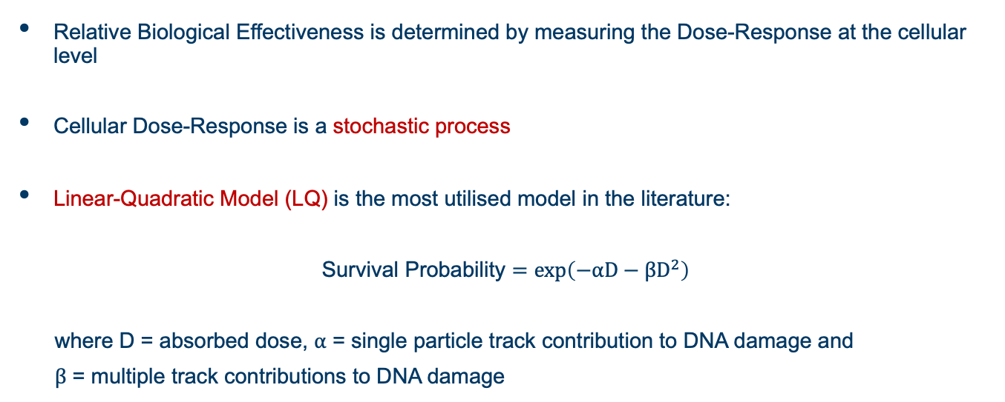
The Problems
Relative Biological Effectiveness is determined by measuring the Dose-Response at the cellular level
Cellular Dose-Response is a stochastic process
Linear-Quadratic Model (LQ) is the most utilised model in the literature:
Survival Probability $=exp\left(−αD−βD^{2}\right)$
where D = absorbed dose, $α$ = single particle track contribution to DNA damage and
$β$ = multiple track contributions to DNA damage
melissa.mcintyre@adelaide.edu.au
4/12

Slide 6
The Problems
Low LET
High LET
Belli et al. 1998
melissa.mcintyre@adelaide.edu.au
5/12

Slide 7
Testing LQ Model on experimental cell survival Dose-Response data
Using statistical testing for regression modelling, the following conclusions were drawn about the LQ Model and Poisson count process:
the goodness-of-fit is not determined rigorously in the literature
The residual fitting errors are not normally distributed for high LET data, which is a requirement for χ² and regression analysis
The residual fitting errors are highly correlated for high LET data, which is forbidden in regression modelling.
The range of validity of the LQ model is restricted to low LET radiation, such as photon radiation and high energy proton radiation
melissa.mcintyre@adelaide.edu.au
6/12

Slide 8
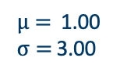




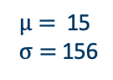
The Problems – An Explanation
Linear-Quadratic Model is based on a Poisson count process
Fitting the Poisson PDF to distributions of lethal damages Poisson process model is adequate at describing low LET data but not high LET data
Lethal lesion PDF data acquired via simulation
$$p_{k}\left(t\right)= \frac{{(λt)}^{k}}{k!}e^{−λt}$$
Low LET (1.2keV/$μ$m) High LET (35keV/$μ$m)
$μ=$1.49
$σ=$ 1.11
$μ=$ 2.90
$σ=$ 4.22
$μ=$ 1.00
$σ=$ 3.00
$μ=$ 15
$σ=$ 156
Probability Density
Number of Lethal DNA Lesions (k)
melissa.mcintyre@adelaide.edu.au
7/12

Slide 9
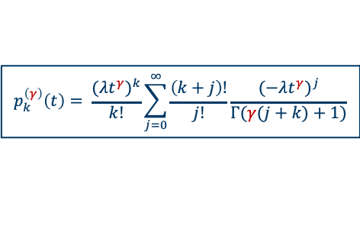
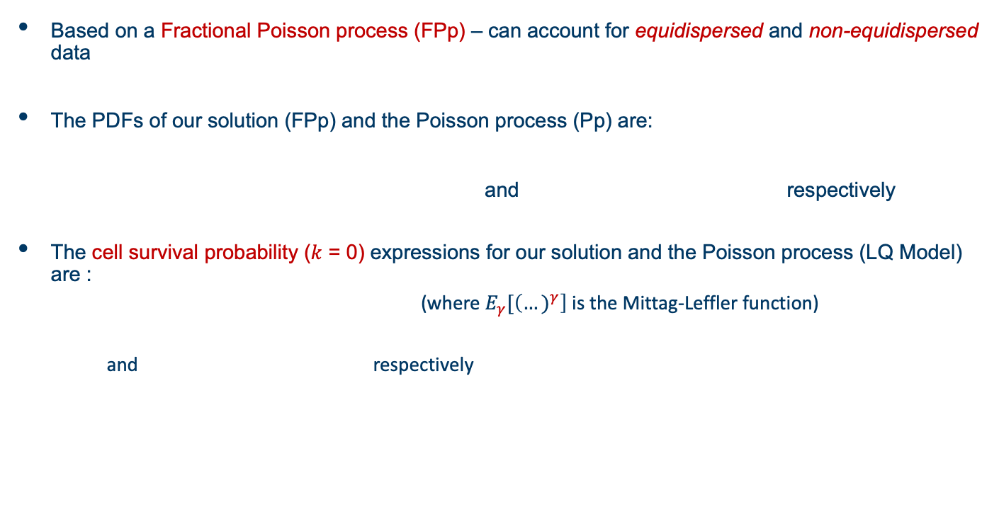


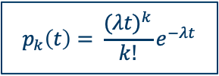
Our Model
Based on a Fractional Poisson process (FPp) – can account for equidispersed and non-equidispersed data
The PDFs of our solution (FPp) and the Poisson process (Pp) are:
and respectively
The cell survival probability ($k$ = 0) expressions for our solution and the Poisson process (LQ Model) are :
(where $E_{γ}[\left(…)^{γ}\right]$is the Mittag-Leffler function)
and respectively
$$p_{k}^{\left(γ\right)}\left(t\right)= \frac{{(λt^{γ})}^{k}}{k!}\sum_{j=0}^{∞}{\frac{\left(k+j\right)!}{j!}\frac{{(−λt^{γ})}^{j}}{Γ(γ(j+k)+1)}}$$
$$p_{k}\left(t\right)= \frac{{(λt)}^{k}}{k!}e^{−λt}$$
$$p_{0}\left(D\right)=E_{γ}[(−αD−βD^{2})^{γ}]$$
$$p_{0}\left(D\right)=e^{−αD−βD^{2}}$$
melissa.mcintyre@adelaide.edu.au
8/12

Slide 10
Our Model
Belli et al. 1998
melissa.mcintyre@adelaide.edu.au
9/12

Slide 11
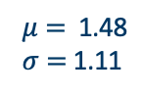
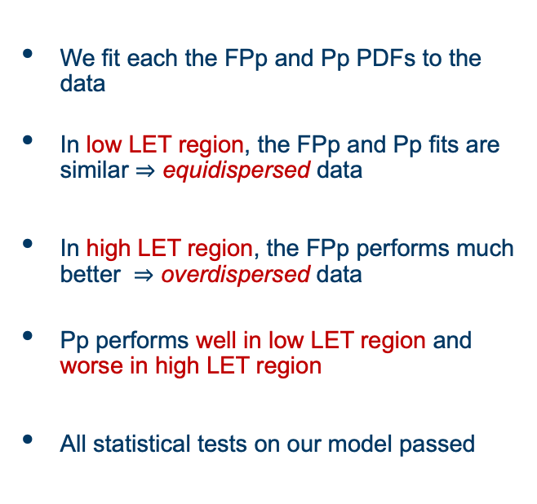


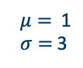
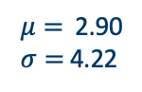
Low LET (1.2keV/$μ$m)
High LET (35keV/$μ$m)
Our Model’s
Performance
We fit each the FPp and Pp PDFs to the data
In low LET region, the FPp and Pp fits are similar $⇒$ equidispersed data
In high LET region, the FPp performs much better $⇒$ overdispersed data
Pp performs well in low LET region and worse in high LET region
All statistical tests on our model passed
$μ=$ 1.48
$σ=$ 1.11
$μ=$ 2.90
$σ=$ 4.22
$μ=$ 1
$σ=$ 3
$μ=$ 15
$σ=$ 156
FPp Pp
melissa.mcintyre@adelaide.edu.au
10/12

Slide 12
Relative Biological Effectiveness Predictions
RBE at 10% survival predictions:
Are similar in the low LET region
Differ more with increasing LET
The improved goodness-of-fit of the FPp model in the high LET region yields better RBE predictions
Using the correct model for RBE predictions decreases uncertainty
Belli et al. 1998
melissa.mcintyre@adelaide.edu.au
11/12

Slide 13
Outcomes & Future Work
Poisson process is a good approximation for low LET dose-response data
The Fractional Poisson process performs much better in the high LET region than the Poisson process for cell survival and lethal DNA damage dose-response data
Using the correct model for each LET domain may reduce the uncertainties seen in RBE predictions for high LET dose-response data
Future Work:
Test the model on more experimental dose-response data, including for endpoints other than cell survival
Perform a more systematic study of RBE uncertainty contributions
Investigate the impact that using a variable RBE and reducing uncertainties has on proton therapy treatment plans
melissa.mcintyre@adelaide.edu.au
12/12

Slide 14
Thank you
melissa.mcintyre@adelaide.edu.au

Slide 15
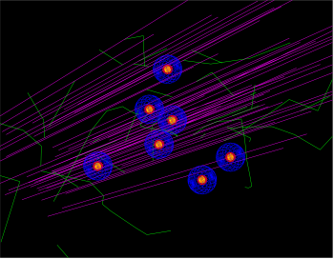
Simulations
Multicellular network of V79 Chinese Hamster cell line irradiated in Geant4-DNA and TOPAS-nBio
Cells were exposed to proton radiation of energies ranging from 1.5 – 50MeV
Ionisations were clustered and sorted into three categories but two categories were used to measure cell death:
Double Strand Break (2 ionisations per 10bp)
Complex Strand Break (>2 ionisations per 10bp)
DNA content of V79 cell used to determine how many damage clusters occur on a DNA segment
Cells allowed 40 hours to repair with Two-Lesion Kinetic Model (Stewart et al. 2001)
The number of lesions that contribute to cell death were counted in each cell
Output
Distribution of k lethal lesions per cell
Dose vs Survival fraction
melissa.mcintyre@adelaide.edu.au

